Slide 1


Slide 2
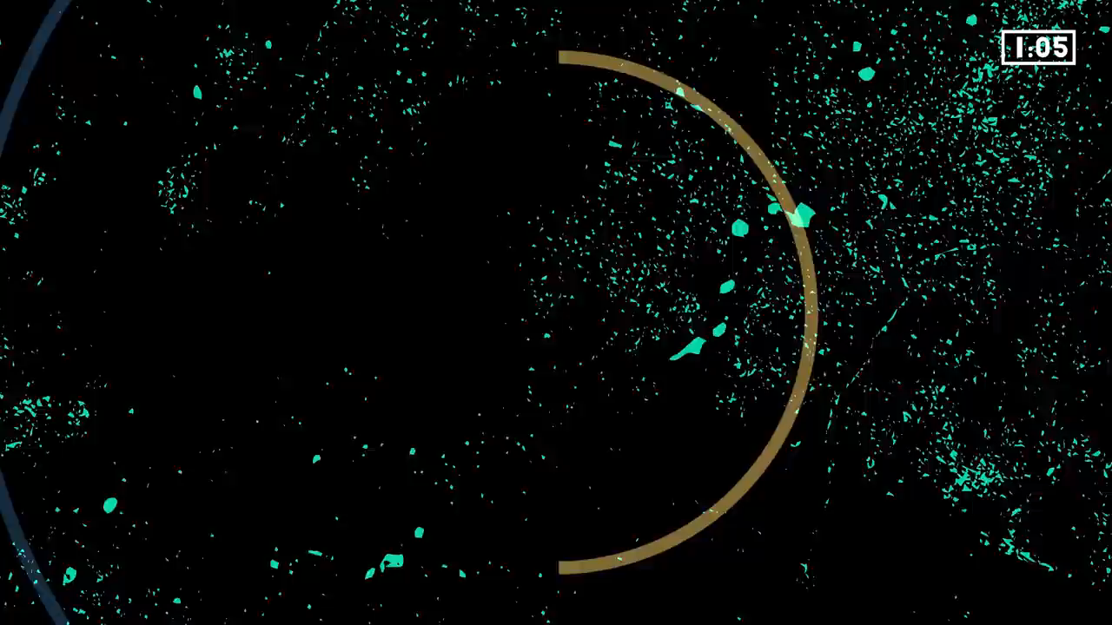

Slide 3
GOD WELCOMES US
We begin this Praise Party worship in the name of the Father…
All: Who gave us our bodies to dance and voices to sing!
In the name of the Son…
All: Who is worthy of our praise!
And in the name of the Holy Spirit…
All: Who is among us in this time of worship. Amen.

Slide 4
WE SING TO GOD
Our first two songs today are ‘……’ and ‘……’
Please stand, join in with the actions
and sing along as we praise and worship God!

Slide 6
GOD LISTENS TO US
Dear God,
…

Slide 7
WE SING TO GOD
Our final song for today is ‘….’
Please stand, sing and dance along with us!

Slide 9
GOD BLESSES US
We now invite Pastor …. forward to share a blessing with us.

