Slide 1
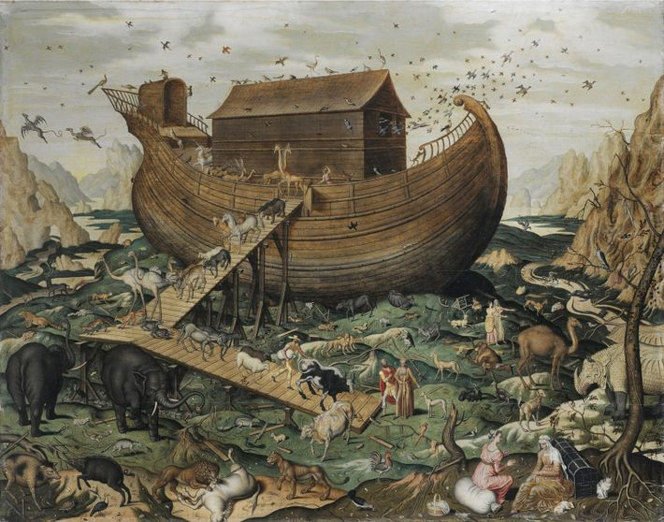
Can you build Noah’s ark?

Slide 2
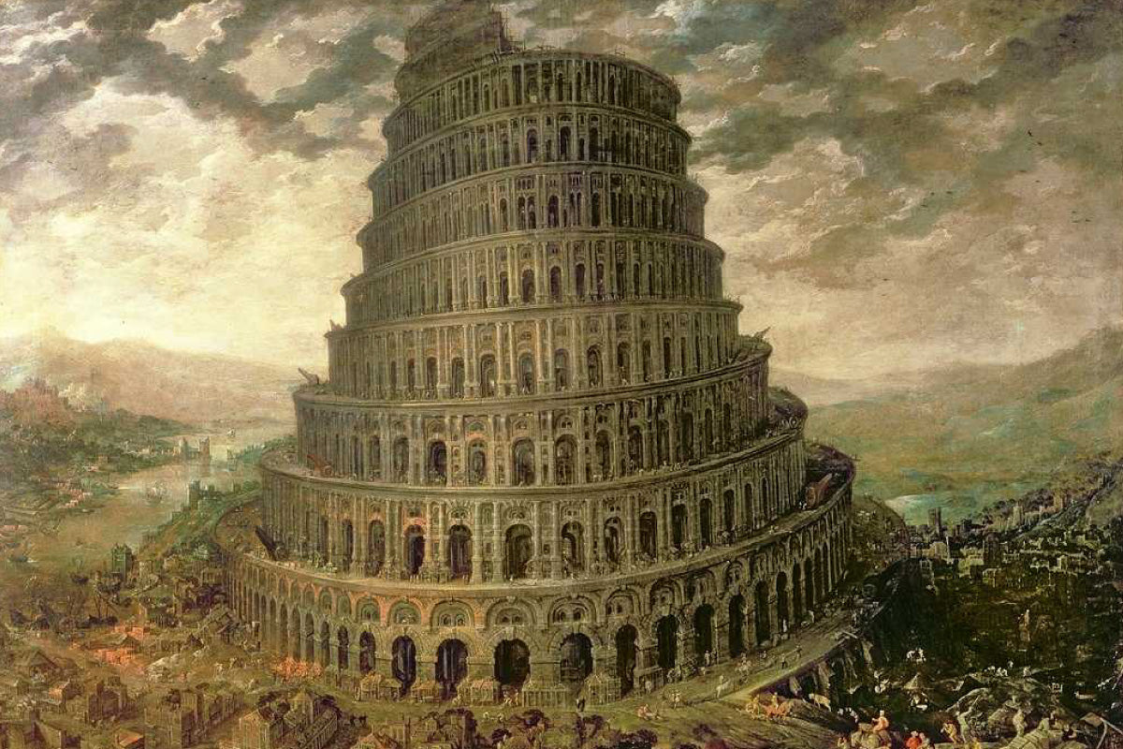
Can you build the Tower of Babel?

Slide 3
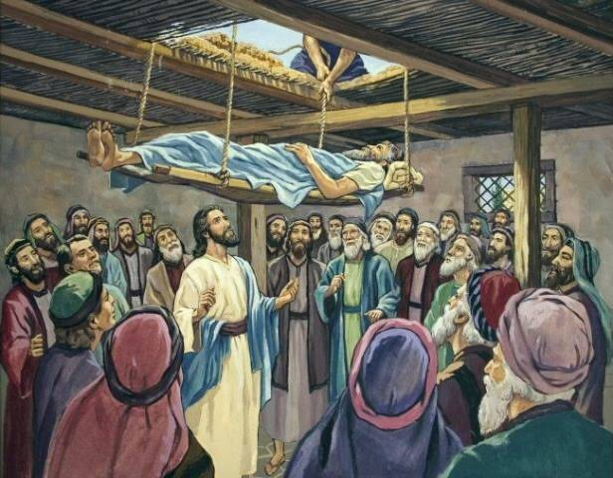
Can you build the house where the paralysed man was healed by Jesus?

Slide 4
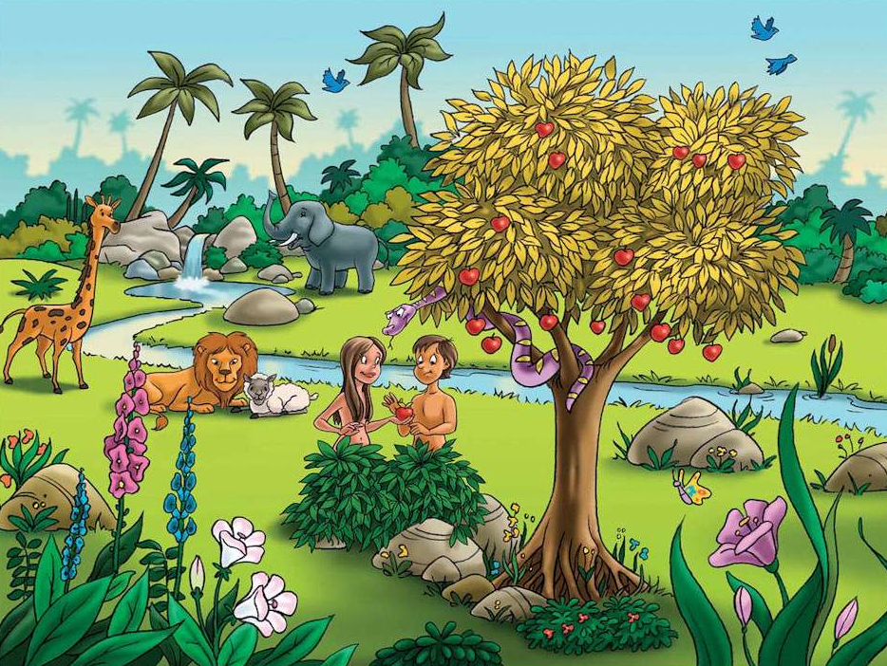
Can you build the Garden of Eden?

Slide 5
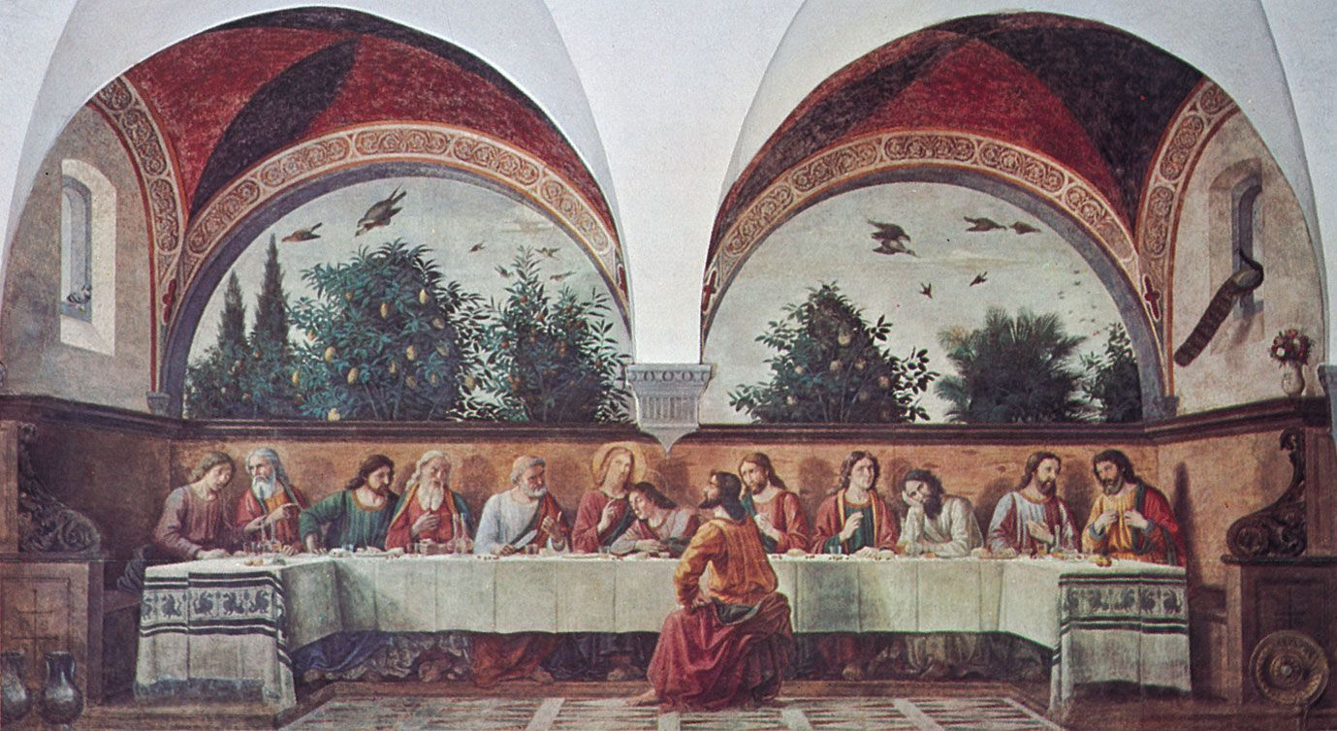
Can you build the room where Jesus and his disciples shared the last supper?

Slide 6
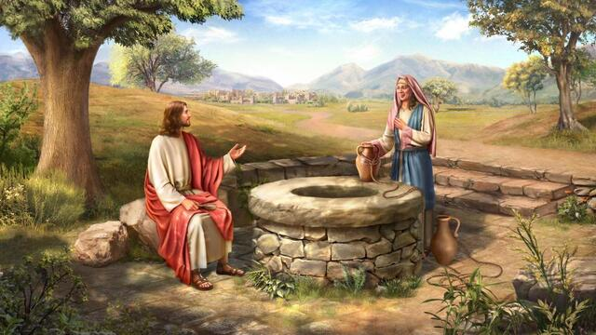
Can you build the well where Jesus spoke with the Samaritan woman?

Slide 7
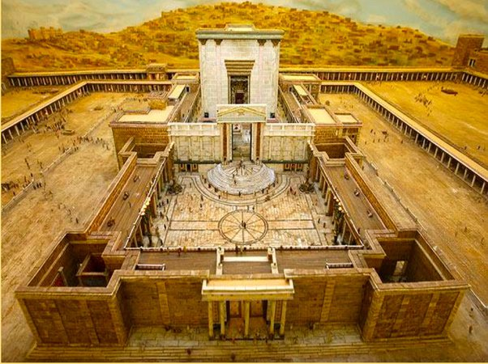
Can you build King Solomon’s temple?

Slide 8
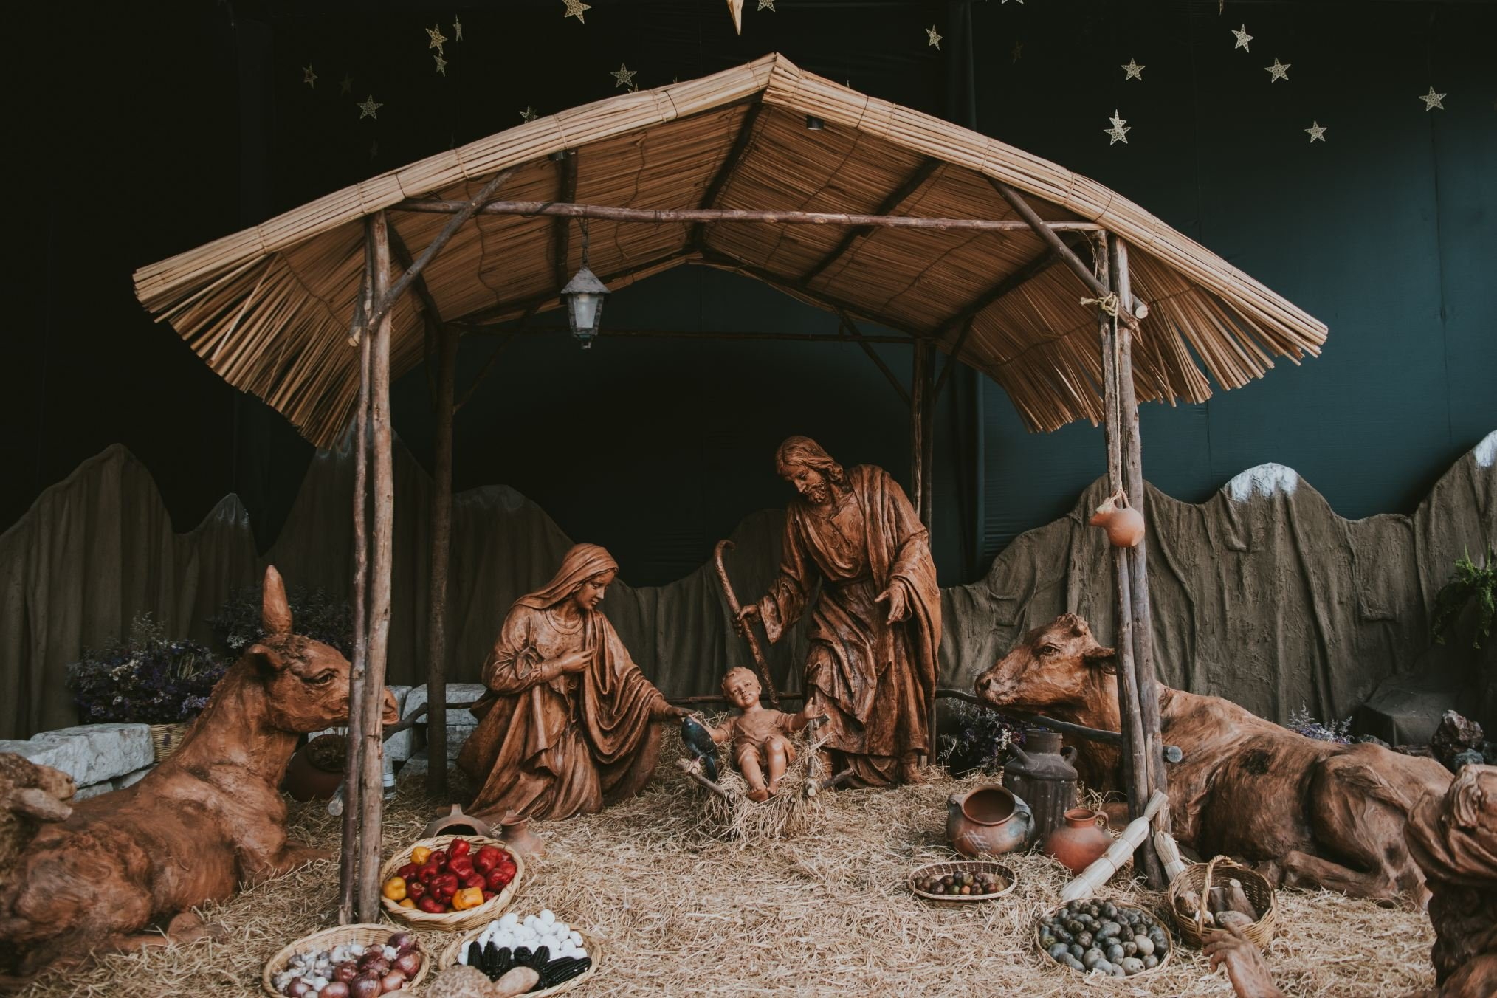
Can you build a stable like the one Jesus was born in?

Slide 9
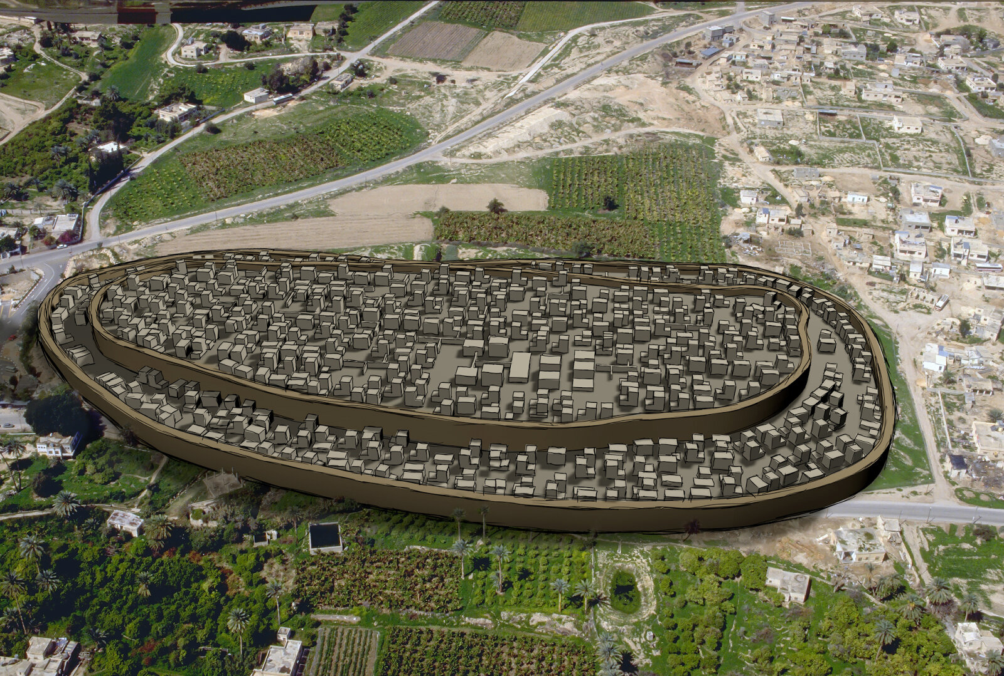
Can you build a city surrounded by walls like Jericho in the Old Testament?

Slide 10
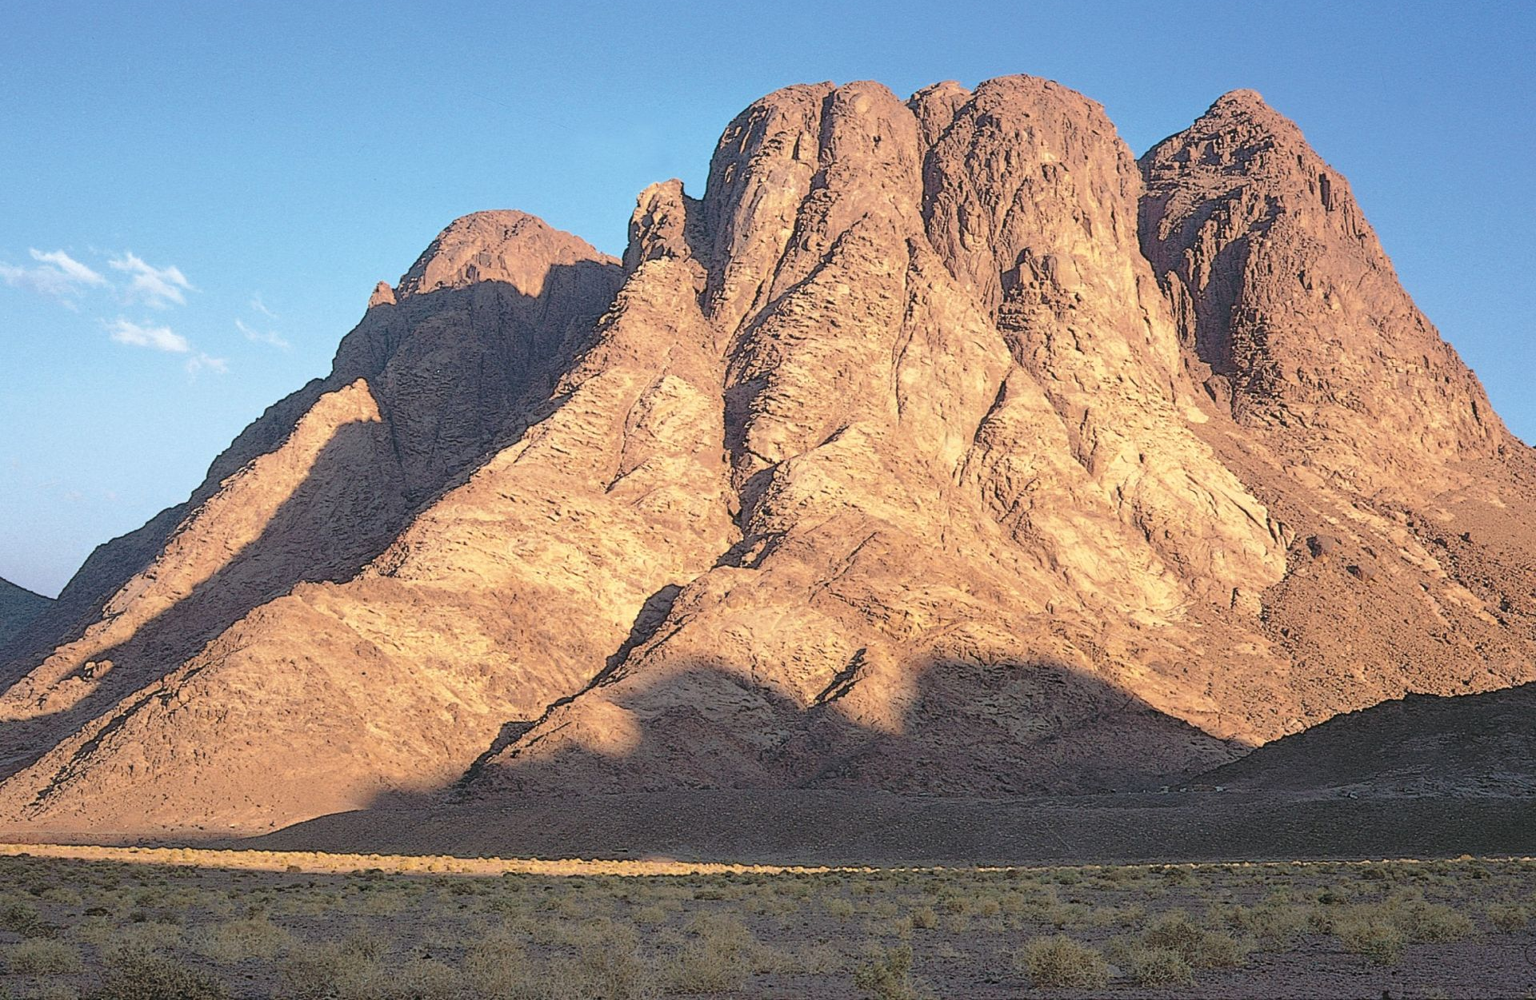
Can you build Mount Sinai, where Moses received the 10 Commandments from God?

Slide 11
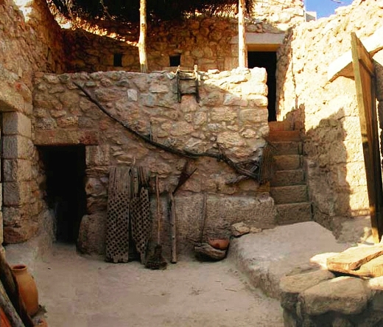
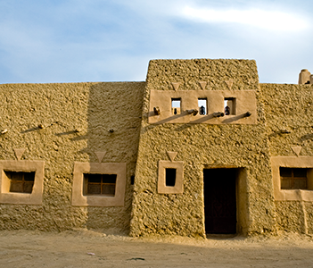
Can you build a typical house in Jesus’ time?

Slide 12
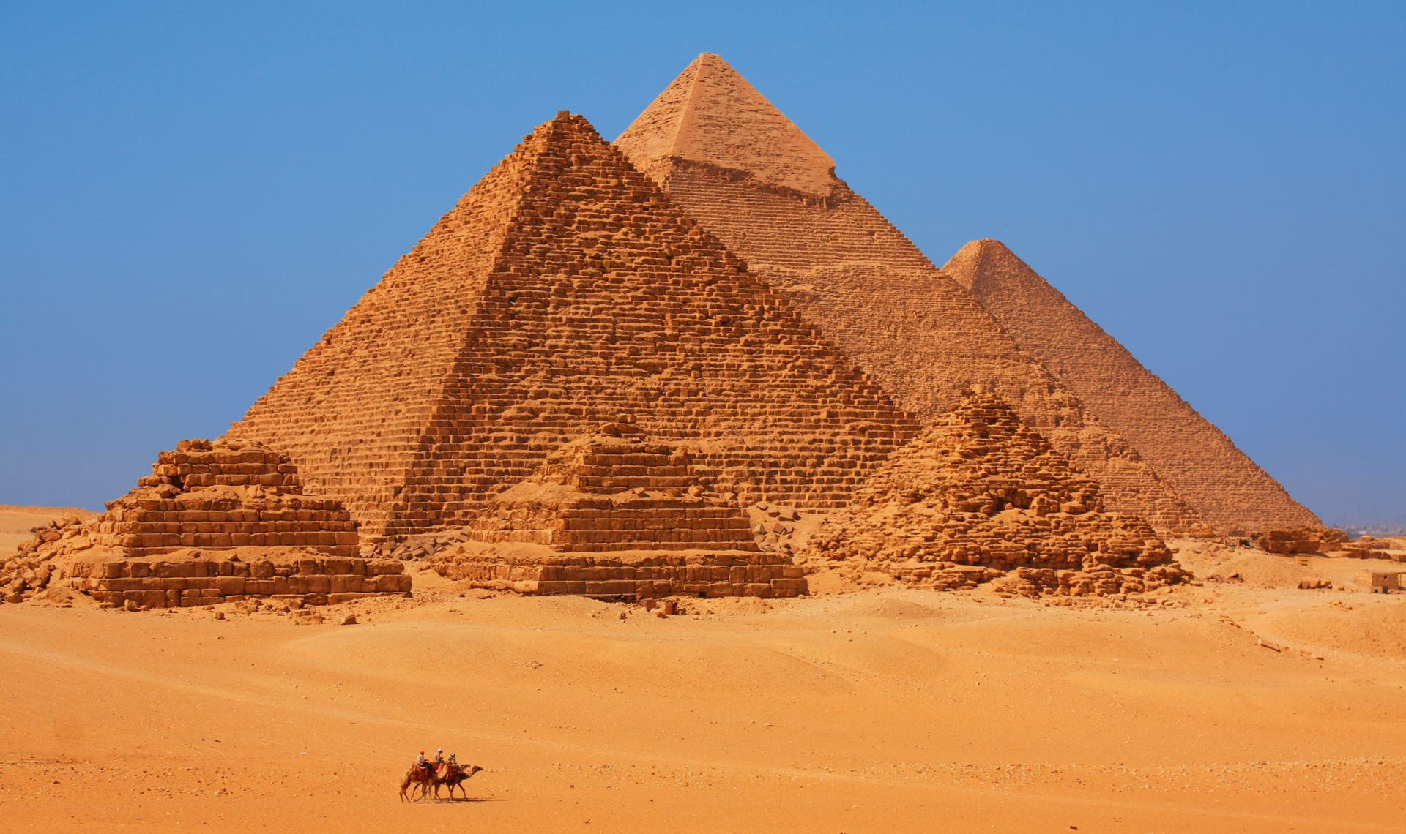
The Israelites were slaves in Egypt for many years. Can you build the pyramids of Egypt?

Slide 13
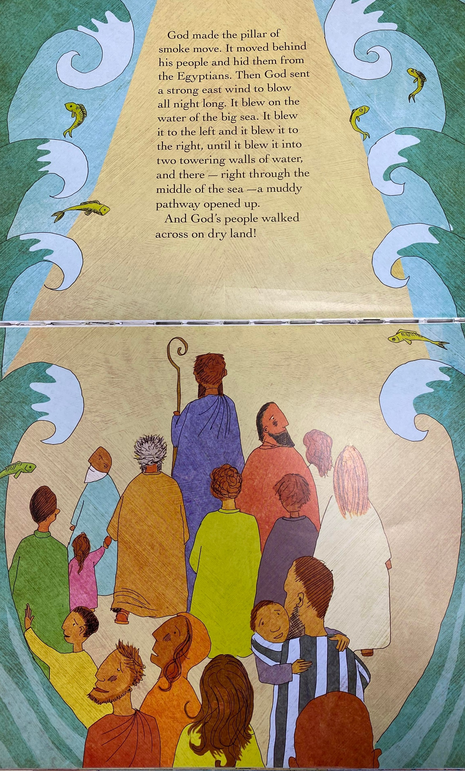
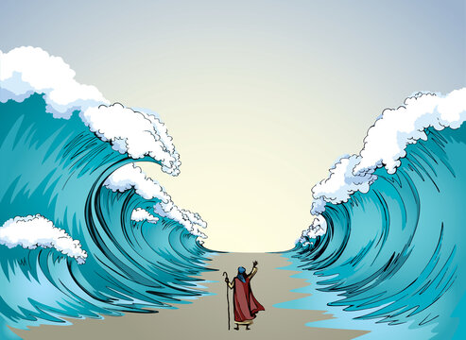
The Israelites were freed from slavery in Egypt when Moses parted the Red Seas. Can you build a model of the parted seas?

Slide 14
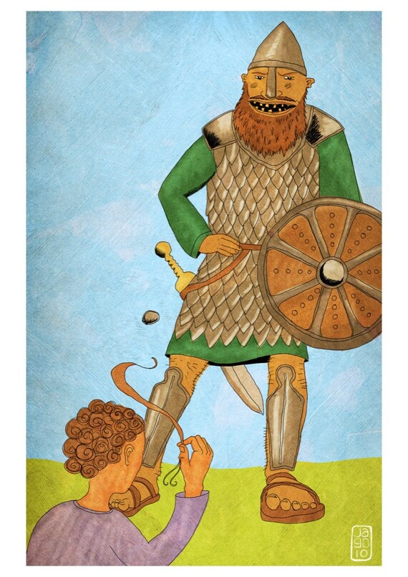
Can you build a model of David and Goliath?

Slide 15
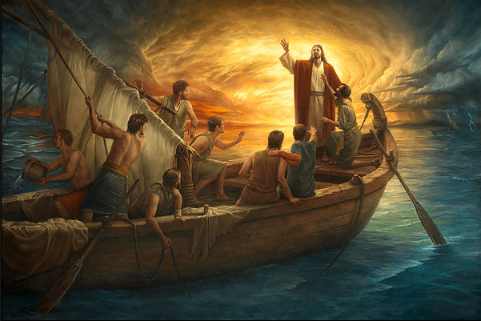
Can you build the boat Jesus was in when he calmed the storm?

Slide 16
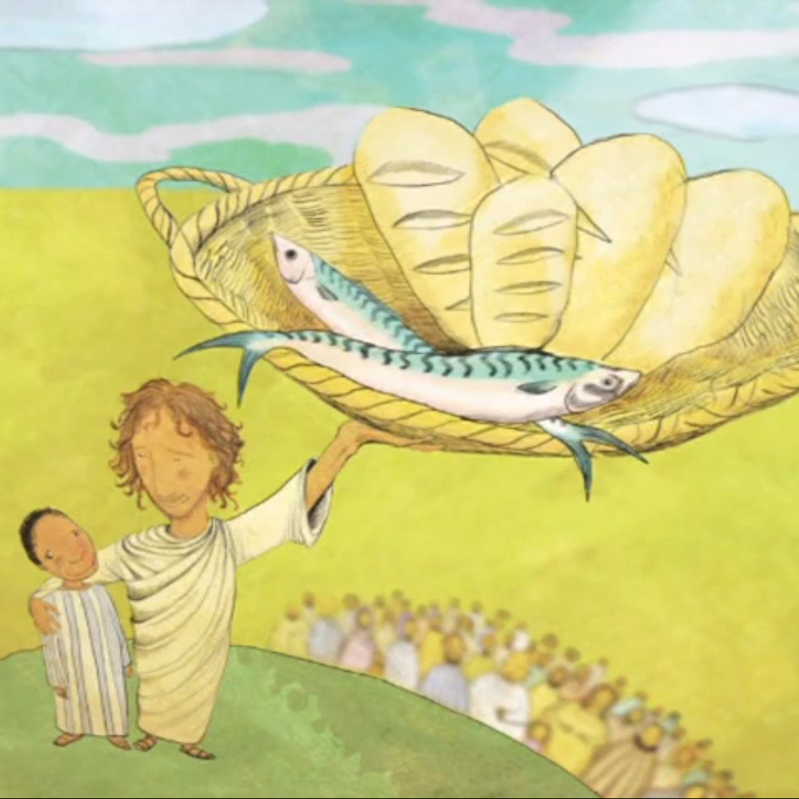
Jesus fed 5000 people with only 5 loaves of bread and 2 fish. Can you build a basket, fish or loaf of bread?

Slide 17
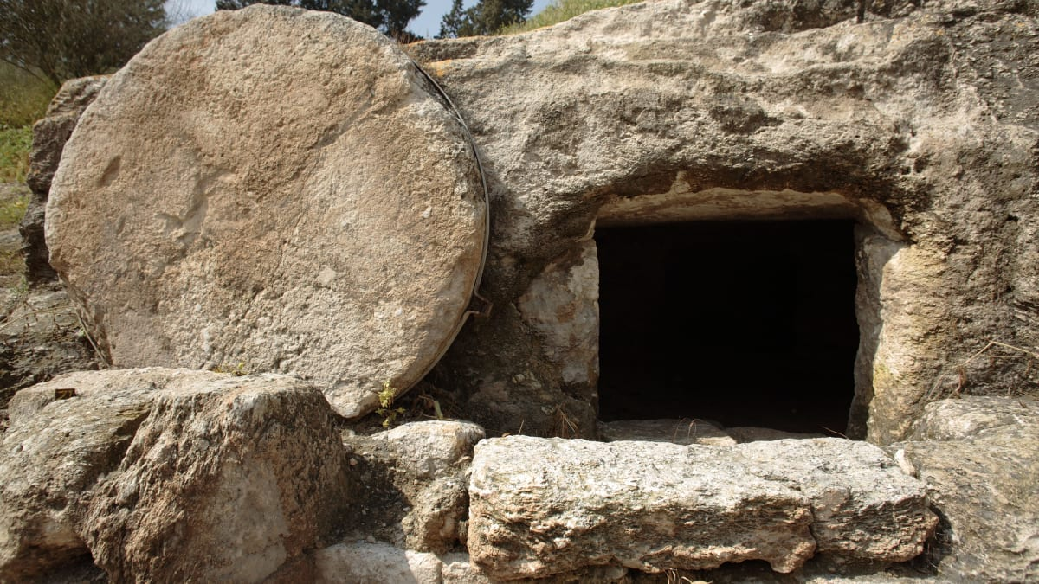
Can you build the tomb where Jesus was buried?

Slide 18
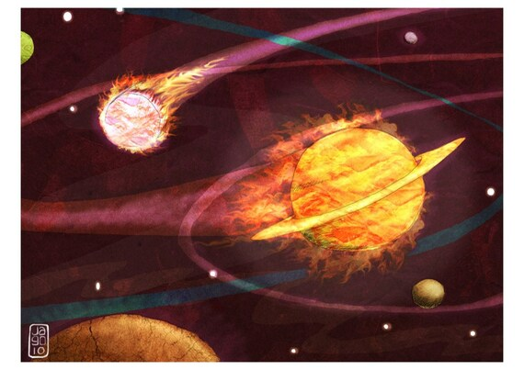
God created the planets by only speaking a word. Can you build a planet?

Slide 19
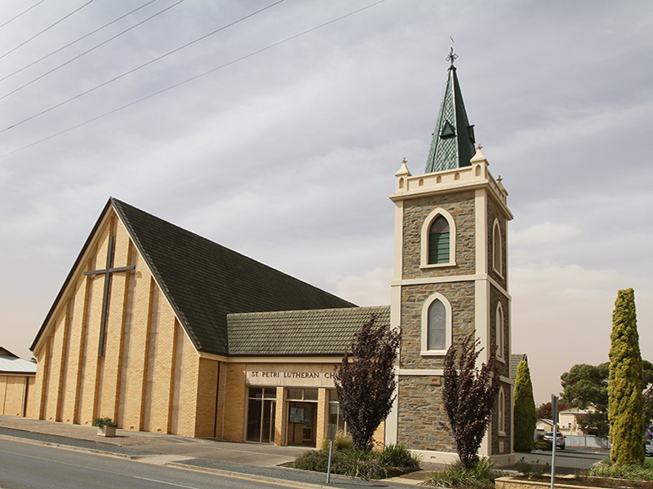
Can you build a model of St Petri Lutheran Church?

